Slide 2

WELCOME TO OUR PRESENTATION
CONTENT
CUSTOMER SCENARIO
SOLUTIONS BASED ON SITUATION
BEST PRACTICE
CODE REVIEW TOOLS ON GITHUB
DEMO
CONTACT INFO
MICHAEL SAM IKECHUKWU
2897008853 , 9055196280
devopscareer2022@outlook.com

Slide 3
CUSTOMER SCENARIO
"Our security team is asking for assistance from us, to ensure that proper review are done to code being added into our repositories. We have hundreds of repositories in our organization. What is the best way we can achieve at scale? We are new to some of the out-of-the-box settings and the GitHub API. Can you please help us create a solution that will accomplish this for our security team?"

Slide 4
SOLUTION
CODE REVIEW
Code review is the most commonly used procedure for validating the design and implementation of features. It helps developers to maintain consistency between design and implementation “styles” across many team members and between various projects on which the company is working.
“Code review is systematic examination … of computer source code. It is intended to find and fix mistakes overlooked in the initial development phase, improving both the overall quality of software and the developers skills.”

Slide 5
Code review can be accomplished in two ways
Peer review
we expect developers to communicate among themselves about their designs intentions and get feedback throughout the (usually non-linear) design/implementation process.
we don’t put limitations on what comments a reviewer might make about the reviewed code.
External review.
An external review addresses different issues than peer reviews. Specifically, external reviews focuses on how to increase code quality, promote best practices, and remove “code smells and hard-coding.”
This level of review will look at the quality of the code itself, it’s potential effects on other areas of the project, and it’s adherence with company coding guideline and policies.

Slide 6
Peer Review
PROS
CONS
Readability and Maintenance
Consistency
Performance
Exceptional Handling and Technical Efficiency
Test Cases
Manual work
Lot of time consuming
Requires a team members

Slide 7
External Review
PROS
CONS
Readability and Maintenance
Coding Style
Code Smells
Feedback
Improving developer’s skills in writing quality code
Showing that the code is been tested
If external reviewer don’t have the knowledge about the logics
If delay in response

Slide 8
Solution
As Best Practice
As previously discussed on the above, the best practice will be based on the unique situation applicable to the team and the project, together with the companies policies, guilines.
Scenario A :
For a small project inside the organization where all team members are working to develop the software, peer-code review will help with any of the code review tool available in the Github API .
Scenario B :
For a small or big project inside the organization where all the team members are working to develop the software . A dedicated Reviewer is required to complete the CodeQL analysis with Github API .

Slide 9
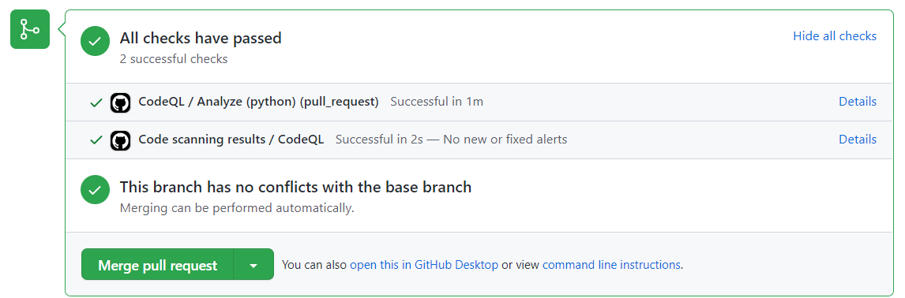
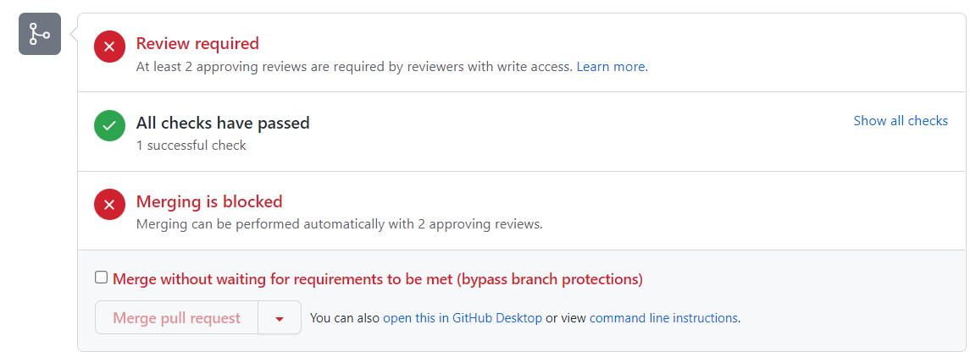
Below image display shows the list of project contributors .
This shows how to add external reviewers to the project.

Slide 10
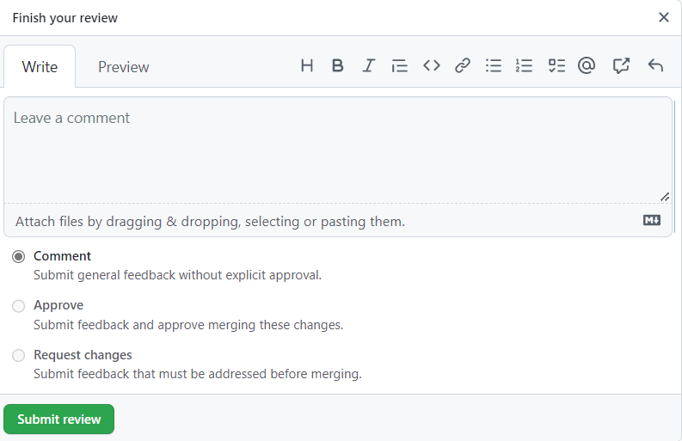
Approval or Denial

Slide 11
Peer Review and External Review Scenario .
Example such as this requires both the external reviewers and peer review team members fully participant on the project in other for the code to be merged.
Note : we will make use of email notification option which will send an email for each push event.

Slide 12
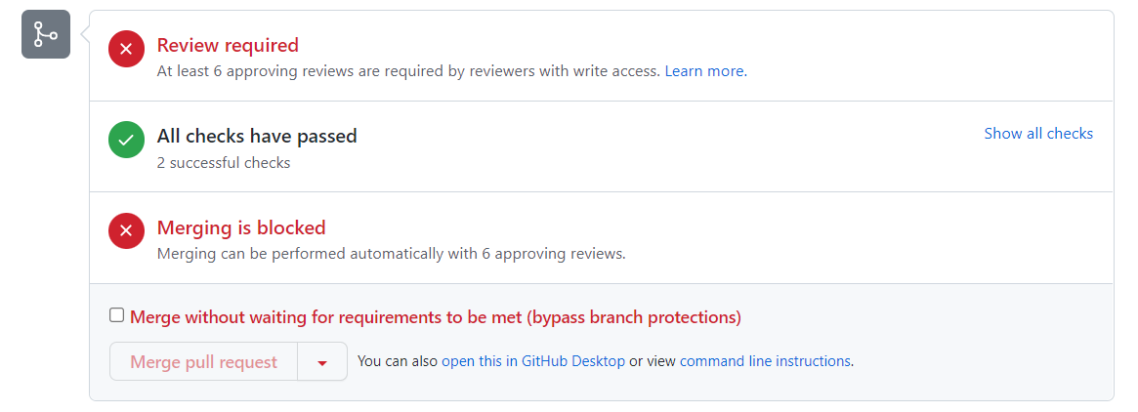
Image below describes a situation where the code is not mergeable unless the appropriate reviewers have completed the codeQL analysis.

Slide 13
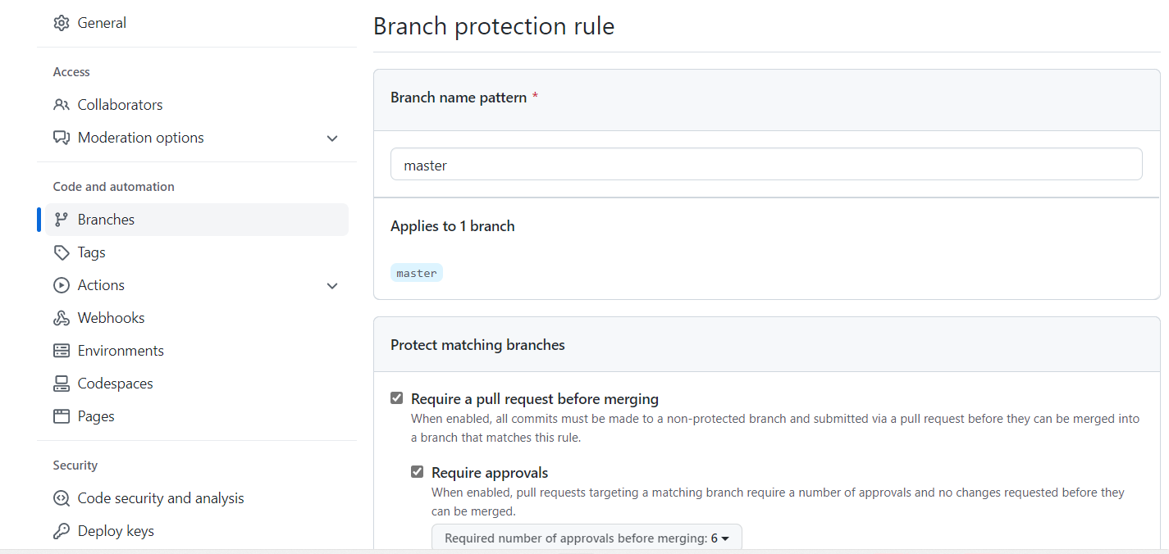
Branch Protection:
Our objective is to make sure that the main branch is protected before merging it with any other branch. So we can add branch merging rule to it example: Main branch protection is inherent and non-negotiable

Slide 14
CODE REVIEW TOOLS AVAILABLE IN GITHUB API
There are 50+ tools are available in Github to do the code review to achieve the code quality and code management .
We are attaching some of them on the below picture but as an example we are using CodeQL Analysis to review our code .
We can use another tools also like Sonar qube , ESLint , Pyre…..ext

Slide 15
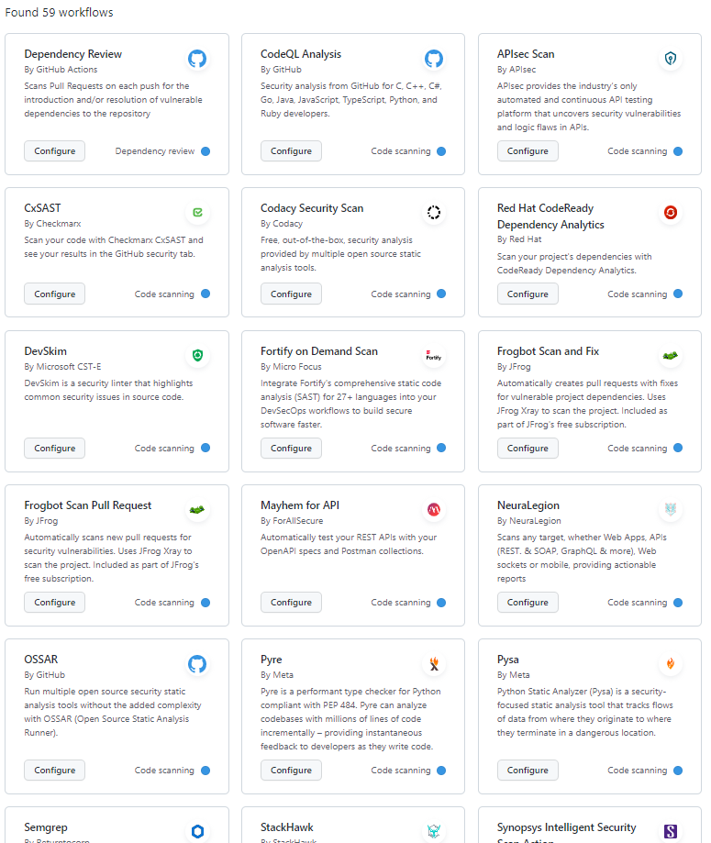

Slide 16

THANK YOU

